Slide 1
Plant Pathogenomics
Training School of the COST Action SUSTAIN on
Genomics of Plant Pathogens
April 3-7, 2016 in Norwich, United Kingdom
DAY 1

Slide 2


Slide 3
Quiz
ls
more
less
nano
pico
cat >> this_file
grep -c “^>” this_file
fasta
fastq
gff/gff3
gtf
sam
bam
vcf
bcf
Garbage In, Garbage Out
Bio in FORMAT ics

Slide 4
Starting up the Virtual Machine
Start the virual machine by double-clicking on ”VirtualBox” icon on the Desktop
Click on “student1”
Enter “Pathogenomics” as password
Download “Day1_demo_files” from Github using following link:
https://github.com/SUSTAIN-COST-Action-Norwich/Day1_demo_files
Start the terminal by selecting from the top Menu Bar “Applications -> Favourites -> Terminal”

Slide 5
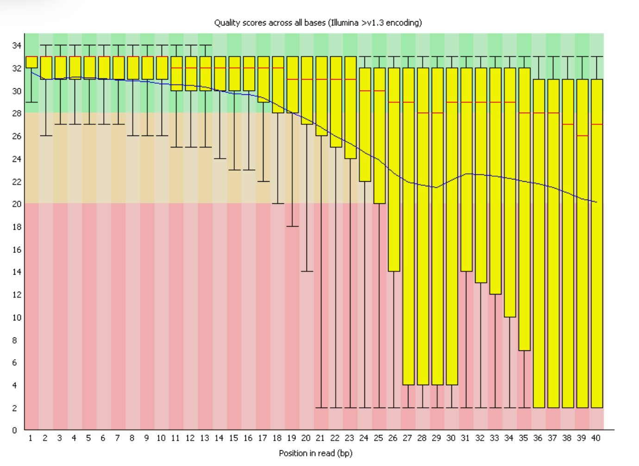
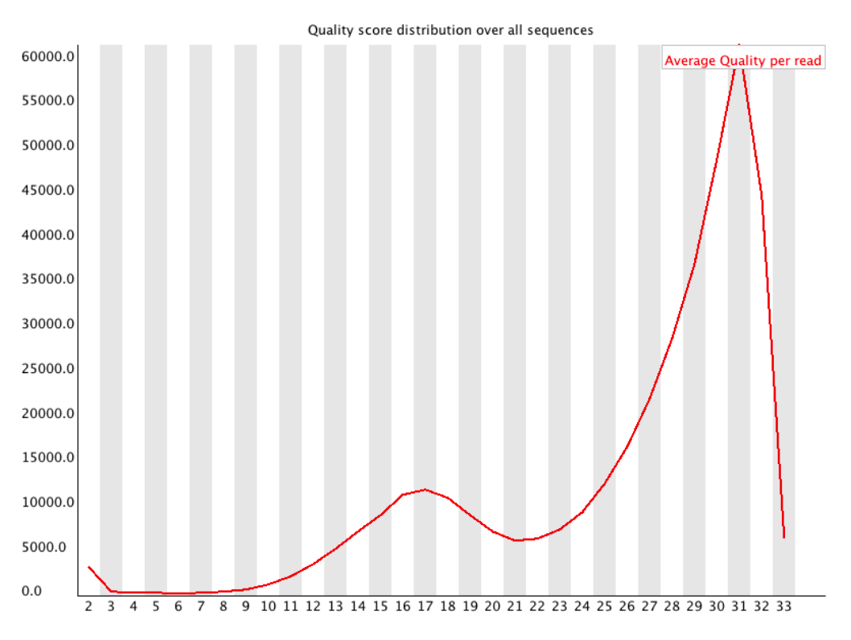
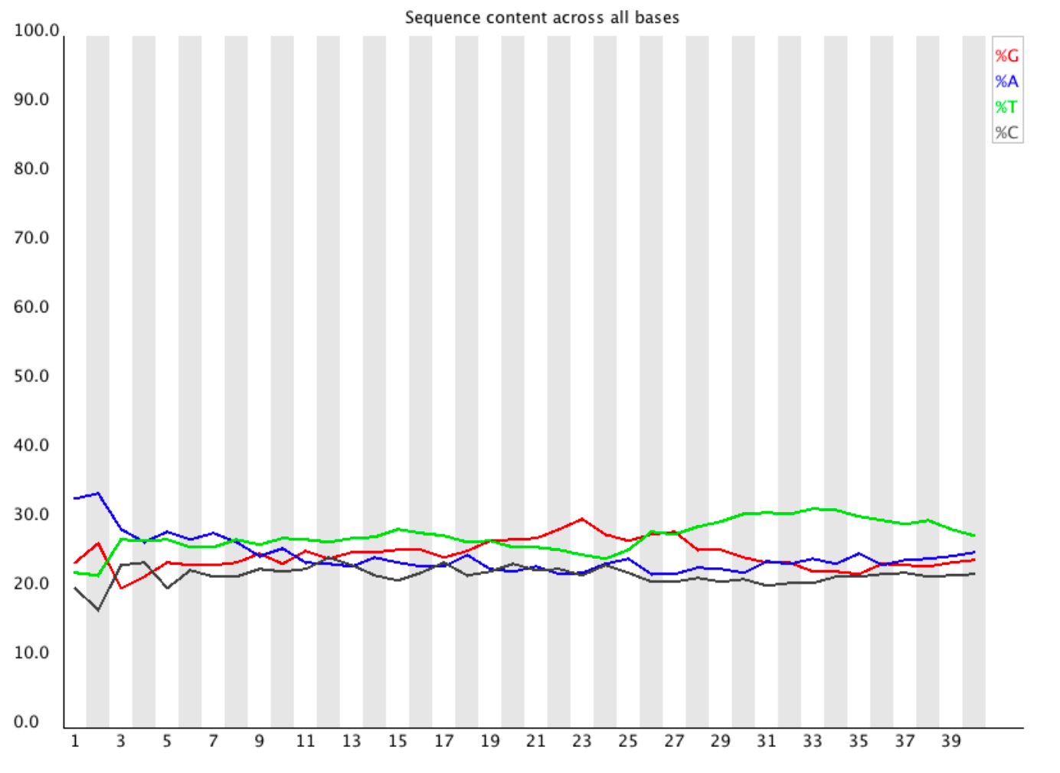
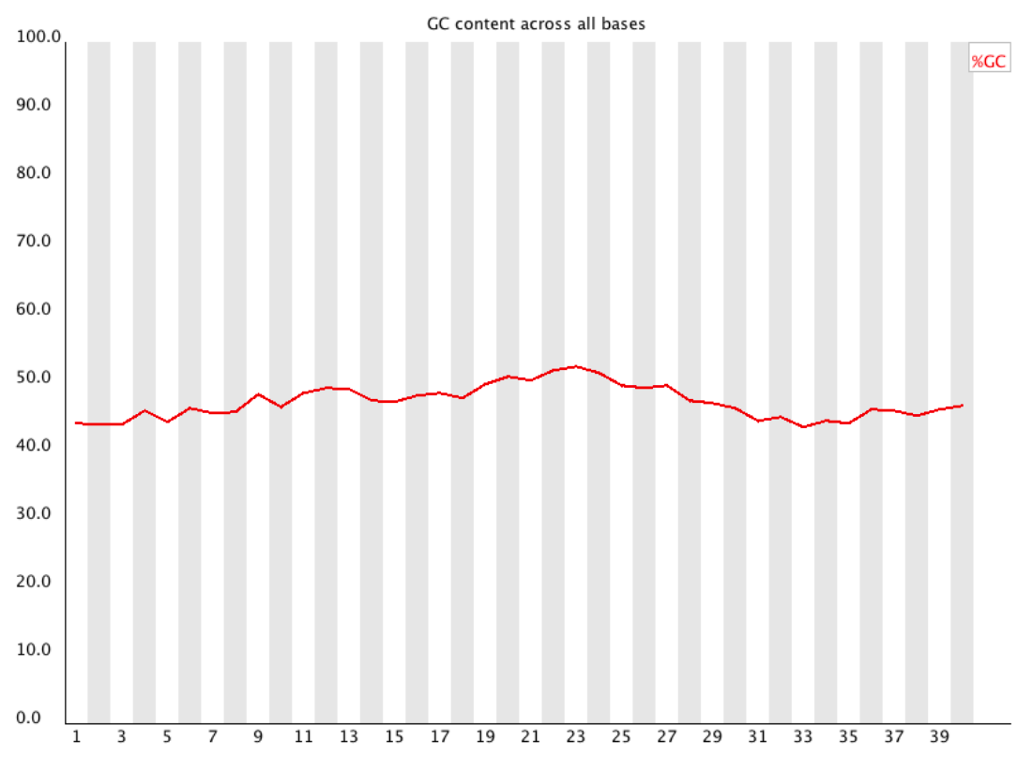
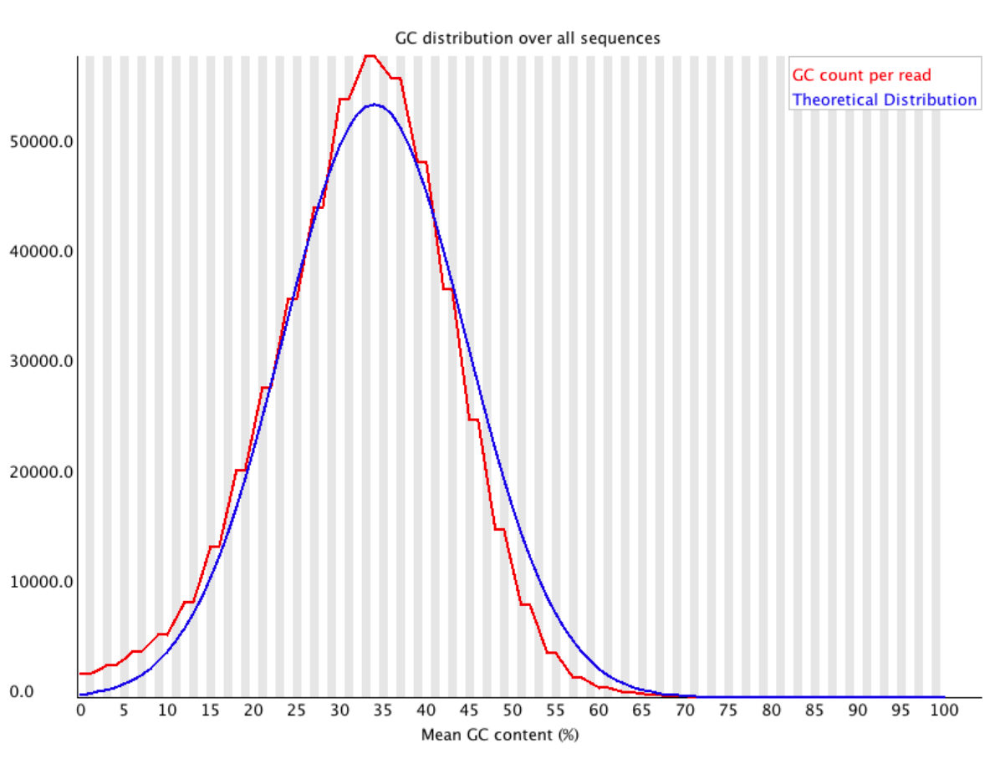
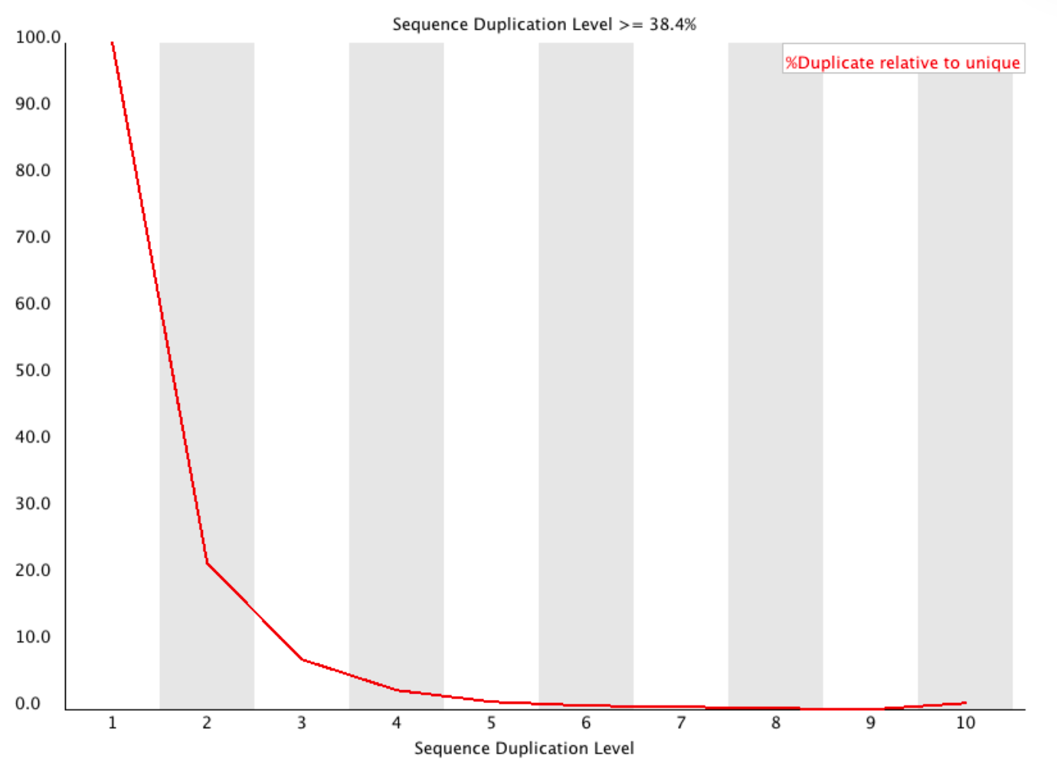
Assessing Read Quality with FastQC
Type “fastqc” at the prompt (without the quotes).
FastQC window should appear. Use “File -> Open” from the menu bar and navigate to the directory containing demo_reads.
Interpretation of results:
https://biof-edu.colorado.edu/videos/dowell-short-read-class/day-4/fastqc-manual

Slide 6
Trimming Reads with Trimmomatic
Navigate to ”Day1_demo_files” in Terminal and type (all in one line!):
java -jar /home/student1/programs/Trimmomatic-0.36/trimmomatic-0.36.jar PE -phred33 demo_reads_LIB1_1.fastq demo_reads_LIB1_2.fastq demo_reads_LIB1_1_paired.fastq demo_reads_LIB1_1_unpaired.fastq demo_reads_LIB1_2_paired.fastq demo_reads_LIB1_2_unpaired.fastq ILLUMINACLIP:TruSeq3-SE:2:30:10 SLIDINGWINDOW:5:20 HEADCROP:17 MINLEN:50
Options used:
ILLUMINACLIP Cut adapter and other illumina-specific sequences from the read.
SLIDINGWINDOW Performs a sliding window trimming approach. It starts scanning at the 5‟ end and clips the read once the average quality within the window falls below a threshold.
HEADCROP Cut the specified number of bases from the start of the read
MINLEN Drop the read if it is below a specified length
Bolger, A. M., Lohse, M., & Usadel, B. (2014). Trimmomatic: A flexible trimmer for Illumina Sequence Data. Bioinformatics, btu170.

Slide 7

RNA-Seq De novo Assembly Using Trinity
Trinity combines three independent software modules: Inchworm, Chrysalis, and Butterfly
Inchworm assembles the RNA-seq data into the unique sequences of transcripts, then reports the unique portions of alternatively spliced transcripts.
Chrysalis clusters the Inchworm contigs into clusters and constructs complete de Bruijn graphs for each cluster.
Butterfly then processes the individual graphs in parallel, tracing the paths that reads and pairs of reads take within the graph, ultimately reporting full-length transcripts for alternatively spliced isoforms, and teasing apart transcripts that corresponds to paralogous genes.
https://github.com/trinityrnaseq/trinityrnaseq/wiki
Haas et al., 2013. De novo transcript sequence reconstruction from RNA-seq using the Trinity platform for reference generation and analysis. Nat Protoc. 8:1494-512.

Slide 8
Running Trinity
Enter at the command prompt:
Trinity --seqType fq --max_memory 2G --left demo_reads_LIB1_1_paired.fastq --right demo_reads_LIB1_2_paired.fastq --CPU 2
Bolger, A. M., Lohse, M., & Usadel, B. (2014). Trimmomatic: A flexible trimmer for Illumina Sequence Data. Bioinformatics, btu170.

Slide 9
Finding Full-length ORFs in Trinity assemblies and annotating their likely origins
Use closely related species (Hyaloperonospora arabidopsis and Arabidopsis thaliana in this case) as tblastn quaries to search Trinity assemblies.
Make the database for blast search:
makeblastdb -in Trinity.fasta –dbtype nucl
Use tblastn to find full-length hits to known sequences:
tblastn -db Trinity.fasta -query arabidopsis_TAIR10.faa -out arabidopsis_tbn_Trinity_fasta_out.txt -evalue 1e-3
tblastn -db Trinity.fasta -query Hyaloperonospora_arabidopsidis_v8.3_14910.faa -out hpa_tbn_Trinity_fasta_out.txt -evalue 1e-3
Use custom perl scripts to extract the full-length ORFs from Trinity assemblies:
perl find_all_full-length_hits.pl arabidopsis_tbn_Trinity_fasta_out.txt > arabidopsis_fl_hits.txt
perl extract_orf.pl arabidopsis_fl_hits.txt Trinity.fasta reseda_orfs.fasta

Slide 10


Mapping reads to reference sequences with Bowtie and TopHat
TopHat is a fast splice junction mapper for RNA-Seq reads. It aligns RNA-Seq reads to genomes using the ultra high-throughput short read aligner Bowtie, and then analyzes the mapping results to identify splice junctions between exons.
https://ccb.jhu.edu/software/tophat/index.shtml
Trapnell C, Pachter L, Salzberg SL. TopHat: discovering splice junctions with RNA-Seq. Bioinformatics doi:10.1093/bioinformatics/btp120

Slide 11
Running TopHat
But first, index the uniORFs_10.fa file for reference usage in Tophat.
Please note that it is highly recommended that a FASTA file with the sequence(s) the genome being indexed be present in the same directory with the Bowtie index files and having the name <genome_index_base>.fa. If not present, TopHat will automatically rebuild this FASTA file from the Bowtie index files.
bowtie2-build -f uniORFs_10.fa uniORFs_10
Now run TopHat by typing at the command prompt:
tophat --read-realign-edit-dist 1000 --mate-inner-dist 49 --mate-std-dev 10 -a 8 -m 0 -i 70 -I 5000 --max-multihits 10 --library-type fr-unstranded --min-segment-intron 20 --max-segment-intron 5000 --min-coverage-intron 20 --max-coverage-intron 5000 --b2-sensitive uniORFs_10 demo_reads_LIB1_1.fastq demo_reads_LIB1_2.fastq

Slide 12
Running TopHat (options used)
--read-realign-edit-dist 1000 Some of the reads spanning multiple exons may be mapped incorrectly as a contiguous alignment to the genome even though the correct alignment should be a spliced one - this can happen in the presence of processed pseudogenes that are rarely (if at all) transcribed or expressed. This option can direct TopHat to re-align reads for which the edit distance of an alignment obtained in a previous mapping step is above or equal to this option value. If you set this option to 0, TopHat will map every read in all the mapping steps (transcriptome if you provided gene annotations, genome, and finally splice variants detected by TopHat), reporting the best possible alignment found in any of these mapping steps. This may greatly increase the mapping accuracy at the expense of an increase in running time. The default value for this option is set such that TopHat will not try to realign reads already mapped in earlier steps.
-r/--mate-inner-dist 49 This is the expected (mean) inner distance between mate pairs. For, example, for paired end runs with fragments selected at 300bp, where each end is 50bp, you should set -r to be 200. The default is 50bp.
--mate-std-dev 10 The standard deviation for the distribution on inner distances between mate pairs. The default is 20bp.
-a/--min-anchor-length 8 The "anchor length". TopHat will report junctions spanned by reads with at least this many bases on each side of the junction. Note that individual spliced alignments may span a junction with fewer than this many bases on one side. However, every junction involved in spliced alignments is supported by at least one read with this many bases on each side. This must be at least 3 and the default is 8.
-m/--splice-mismatches 0 The maximum number of mismatches that may appear in the "anchor" region of a spliced alignment. The default is 0.
-i/--min-intron-length 70 The minimum intron length. TopHat will ignore donor/acceptor pairs closer than this many bases apart. The default is 70.
-I/--max-intron-length 5000 The maximum intron length. When searching for junctions ab initio, TopHat will ignore donor/acceptor pairs farther than this many bases apart, except when such a pair is supported by a split segment alignment of a long read. The default is 500000.-p/--num-threads 2 Use this many threads to align reads. The default is 1.
-g/--max-multihits 10 Instructs TopHat to allow up to this many alignments to the reference for a given read, and choose the alignments based on their alignment scores if there are more than this number. The default is 20 for read mapping. Unless you use --report-secondary-alignments, TopHat will report the alignments with the best alignment score. If there are more alignments with the same score than this number, TopHat will randomly report only this many alignments. In case of using --report-secondary-alignments, TopHat will try to report alignments up to this option value, and TopHat may randomly output some of the alignments with the same score to meet this number.
--library-type fr-unstranded The default is unstranded (fr-unstranded). If either fr-firststrand or fr-secondstrand is specified, every read alignment will have an XS attribute tag as explained below. Consider supplying library type options below to select the correct RNA-seq protocol.
--min-segment-intron 20 The minimum intron length that may be found during split-segment search. The default is 50.
--max-segment-intron 5000 The maximum intron length that may be found during split-segment search. The default is 500000.
--min-coverage-intron 20 The minimum intron length that may be found during coverage search. The default is 50.
--max-coverage-intron 5000 The maximum intron length that may be found during coverage search. The default is 20000.
--b2-sensitive

Slide 13
Use Samtools to extract mapping information and “synthetic transcripts”
Samtools is a suite of programs for interacting with high-throughput sequencing data. It consists of three separate repositories:
Samtools Reading/writing/editing/indexing/viewing SAM/BAM/CRAM format
BCFtools Reading/writing BCF2/VCF/gVCF files and calling/filtering/summarising SNP and short indel sequence variants
HTSlibA C library for reading/writing high-throughput sequencing data
We need more Heng Li’s!
Li H., Handsaker B., Wysoker A., Fennell T., Ruan J., Homer N., Marth G., Abecasis G., Durbin R. and 1000 Genome Project Data Processing Subgroup (2009) The Sequence alignment/map (SAM) format and SAMtools. Bioinformatics, 25, 2078-9.

Slide 14
Use samtools to extract mapping information and “synthetic transcripts”
Sort the alignments in bam file:
samtools sort -o accepted_hits_sorted.bam accepted_hits.bam
Index the sorted bam file
samtools index accepted_hits_sorted.bam
Get some statistics on the sorted bam file
samtools idxstats accepted_hits_sorted.bam > accepted_hits_sorted.bam.stats
Generate synthetic transcripts using samtools and bcftools
samtools mpileup -A -E -uf uniORFs_10.fa accepted_hits_sorted.bam | bcftools call -c | vcfutils.pl vcf2fq > cns_uniORFs_10_cns.fastq

